Slide 1


IT Project Scheduling
Prepared by:
MR. CELSO T. AGOS JR.,MSIT
Microsoft Certified Educator
Six Sigma Certified
Science and Technological Specialist
Doctor in Information Technology- on going

Slide 2
Project cost management
project cost management focuses on the processes, procedures, and techniques to develop and manage the project budget. According to PMBOK, project cost management includes:
Resource planning—Identifying the type of resources (people, technology, facilities, and so forth) and number of resources needed to carry out the project activities.
Cost estimating—Based upon the activities, their time estimates, and resource requirements, an estimate can be developed.
Prepared by:
MR. CELSO T. AGOS JR.,MSIT
Microsoft Certified Educator
Six Sigma Certified
Science and Technological Specialist
Doctor in Information Technology- on going

Slide 3
Cost budgeting—Once the time and cost of each activity is estimated, an overall cost estimate for the entire project can be made. Once approved, this estimate becomes the project budget.
Cost control—Ensuring that proper processes and procedures are in place to control changes to the project budget. Once the project schedule and budget are determined, the total time and cost of each activity can be summed using a bottom-up approach to determine a target deadline and budget. The schedule and budget must, however, be reviewed and accepted by the project sponsor or client. This may require several revisions and possible trade-offs before the scope, schedule, and budget
Prepared by:
MR. CELSO T. AGOS JR.,MSIT
Microsoft Certified Educator
Six Sigma Certified
Science and Technological Specialist
Doctor in Information Technology- on going

Slide 4
Developing project schedule
Working with the U.S. Army during World War I, Henry L. Gantt developed a visual representation that compares a project's planned activities with actual progress over time. Although Gantt charts have been around for a long time, they are still one of the most useful and widely used project management tools.
Prepared by:
MR. CELSO T. AGOS JR.,MSIT
Microsoft Certified Educator
Six Sigma Certified
Science and Technological Specialist
Doctor in Information Technology- on going

Slide 5
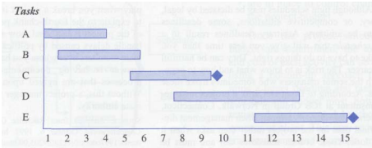
Figure below shows how a basic Gantt chart can be used for planning. Estimates for the tasks or activities defined in the WBS are represented using a bar across a horizontal time axis. Other symbols, for example, diamonds, can represent milestones to make the Gantt chart more useful.
Project network diagram
Project network diagrams include several useful tools for planning, scheduling, and monitoring the project's progress. Similar to Gantt charts, project network diagrams
Prepared by:
MR. CELSO T. AGOS JR.,MSIT
Microsoft Certified Educator
Six Sigma Certified
Science and Technological Specialist
Doctor in Information Technology- on going

Slide 6
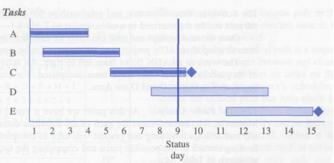
Gantt charts can also be useful for tracking and monitoring the progress of a project. As shown in Figure below, completed tasks can be shaded or filled in, and one can get an accurate picture of where the project stands for a given status or reporting date. In Figure below, tasks A and B have been completed, but it looks like Task C is somewhat behind schedule.
Prepared by:
MR. CELSO T. AGOS JR.,MSIT
Microsoft Certified Educator
Six Sigma Certified
Science and Technological Specialist
Doctor in Information Technology- on going

Slide 7
Activity on the Node (AON)
An activity or task focuses on producing a specific project deliverable, generally takes a specific amount of time to complete, and requires resources. Activity on the Node (AON) is a project network diagramming tool that graphically represents all of the project activities and tasks, as well as their logical sequence and dependencies. Using AON, activities are represented as boxes (i.e. nodes) and arrows indicate precedence and flow.
Prepared by:
MR. CELSO T. AGOS JR.,MSIT
Microsoft Certified Educator
Six Sigma Certified
Science and Technological Specialist
Doctor in Information Technology- on going

Slide 8
To construct an AON network diagram, one begins with the activities and tasks that were defined in the WBS. Estimates for each activity or task defined in the WBS should have an associated time estimate. The next step is to determine which activities are predecessors, successors, or parallel.
Predecessor activities are those activities that must be completed before another activity can be started—e.g., a computer's operating system must be installed before loading an application package.
Prepared by:
MR. CELSO T. AGOS JR.,MSIT
Microsoft Certified Educator
Six Sigma Certified
Science and Technological Specialist
Doctor in Information Technology- on going

Slide 9
successor activities are activities that must follow a particular activity in some type of sequence. For example, a program must be tested and then documented after it is compiled.
A parallel activity is an activity or task that can be worked on at the same time as another activity. Parallel activities may be thought of as an opportunity to shorten the project schedule; however, they also can be a trade-off since doing more than one thing at the same time can have a critical impact on project resources.
Prepared by:
MR. CELSO T. AGOS JR.,MSIT
Microsoft Certified Educator
Six Sigma Certified
Science and Technological Specialist
Doctor in Information Technology- on going

Slide 10
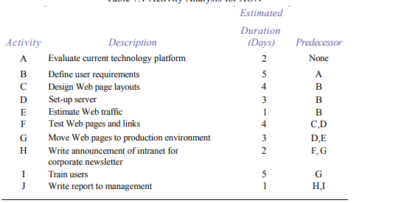
Activity Analysis on AON
Prepared by:
MR. CELSO T. AGOS JR.,MSIT
Microsoft Certified Educator
Six Sigma Certified
Science and Technological Specialist
Doctor in Information Technology- on going

Slide 11
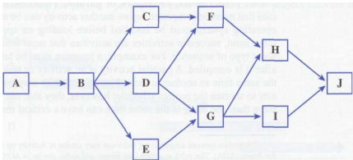
Activity on the NOD Network Diagram
Prepared by:
MR. CELSO T. AGOS JR.,MSIT
Microsoft Certified Educator
Six Sigma Certified
Science and Technological Specialist
Doctor in Information Technology- on going

Slide 12
Critical Path Analysis At this point we have a visual road map of our project. Moreover, the time estimates for each of the activities determines the project schedule and tells us how long our project will take to complete. This is determined by looking at each of the possible paths and computing the total duration for each path, as shown in the activity analysis table on the previous slide.
Prepared by:
MR. CELSO T. AGOS JR.,MSIT
Microsoft Certified Educator
Six Sigma Certified
Science and Technological Specialist
Doctor in Information Technology- on going

Slide 13
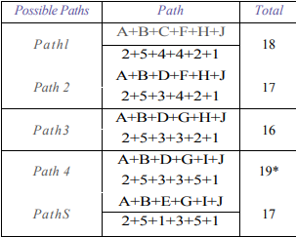
Possible Activity Paths The critical path is the longest path in the project network and is also the shortest time in which the project can be completed. Identifying the critical path is a major concern to the project manager because any change in the duration of the activities or tasks on the critical path will affect the project's schedule
Prepared by:
MR. CELSO T. AGOS JR.,MSIT
Microsoft Certified Educator
Six Sigma Certified
Science and Technological Specialist
Doctor in Information Technology- on going

Slide 14
. In other words, the critical path has zero slack (or float). Slack, which is sometimes called float, is the amount of time an activity can be delayed, that is, take longer than expected, before it delays the project. For example, Activity E is not on the critical path.
Prepared by:
MR. CELSO T. AGOS JR.,MSIT
Microsoft Certified Educator
Six Sigma Certified
Science and Technological Specialist
Doctor in Information Technology- on going

Slide 15
In fact, the only path that includes Activity E is Path 5. Subsequently, the start of Activity E could be delayed for two days or take up to three days to complete before the project schedule is affected. On the other hand, Activities A, B, D, G, I, and J have no float because delaying
Prepared by:
MR. CELSO T. AGOS JR.,MSIT
Microsoft Certified Educator
Six Sigma Certified
Science and Technological Specialist
Doctor in Information Technology- on going

Slide 16
their start or taking longer to complete that we estimated will increase the total duration of the project by the same amount As a result, knowing the critical path can influence a project manager's decisions. For example, a project manager can expedite, or crash, the project by adding resources to an activity on the critical path to shorten its duration.
The project manager may even be able to divert resources from certain activities, for example, Activity E because this activity has some slack or float. Diverting resources will reduce the overall project schedule, but keep in mind that there may be a trade-off—shortening the schedule by adding more resources may inflate the project's budget.
Prepared by:
MR. CELSO T. AGOS JR.,MSIT
Microsoft Certified Educator
Six Sigma Certified
Science and Technological Specialist
Doctor in Information Technology- on going

Slide 17
Monitor and Control Project Work
Monitoring and Controlling Project Work involves tracking the actual project performance with the planned project management activities. It can mainly be looked as a Control function that takes place at all stages of a project i.e. from Initiation through Closing. For small projects, monitoring and control project work is comparatively an easy task. However, as you are aware, Project Management is more stringently required for large projects where the project manager requires a formal effort to monitor and control how the processes are going. He or she will not be personally involved in performing project work in large projects.
Prepared by:
MR. CELSO T. AGOS JR.,MSIT
Microsoft Certified Educator
Six Sigma Certified
Science and Technological Specialist
Doctor in Information Technology- on going

Slide 18
When you think about monitoring and controlling project work, you should take into consideration that it is measuring against the project management plan.
Change Requests
Changes are inevitable. In spite of planning the project to the minutest detail, a project manager will come across changes during the course of the project. These changes are additions to the projects. They may also be changes to the existing policies and procedures used on the project.
Prepared by:
MR. CELSO T. AGOS JR.,MSIT
Microsoft Certified Educator
Six Sigma Certified
Science and Technological Specialist
Doctor in Information Technology- on going

Slide 19
Preventive Action
Taking corrective actions is a reactive approach whereas taking preventive actions is a proactive approach. It means dealing with anticipated or possible deviations from the performance measurement baseline. Knowing when to take preventive actions requires more experience than a mere understanding of the project management framework, hence, the process of taking preventive actions is not as clear as corrective actions. Some of the examples of preventive actions include:
Prepared by:
MR. CELSO T. AGOS JR.,MSIT
Microsoft Certified Educator
Six Sigma Certified
Science and Technological Specialist
Doctor in Information Technology- on going

Slide 20
Changing a vendor because their products nearly failed to meet the acceptance criteria
Cross-skilling the team members on certain specialized tasks to manage to staff and work in case the specialized staff inadvertently falls ill or misses work
Perform Integrated Change Control will also be applicable to any preventive action. Preventive actions could change the project management plan, baselines, policies or procedures, charter, contract, or statement of work.
Prepared by:
MR. CELSO T. AGOS JR.,MSIT
Microsoft Certified Educator
Six Sigma Certified
Science and Technological Specialist
Doctor in Information Technology- on going

Slide 21
Defect Repair
Another word for Defect Repair is “Rework”. When a component of the project does not produce the required output or does not meet the required specifications, a defect repair may be requested. A defect repair may change the project management plan, baselines, policies or procedures, charter, contract, or statement of work, hence, it has to go through a Perform Integrated Change Control Process.
Prepared by:
MR. CELSO T. AGOS JR.,MSIT
Microsoft Certified Educator
Six Sigma Certified
Science and Technological Specialist
Doctor in Information Technology- on going

Slide 22
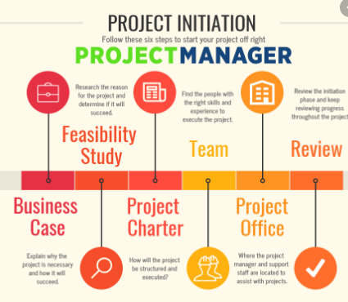

Slide 23
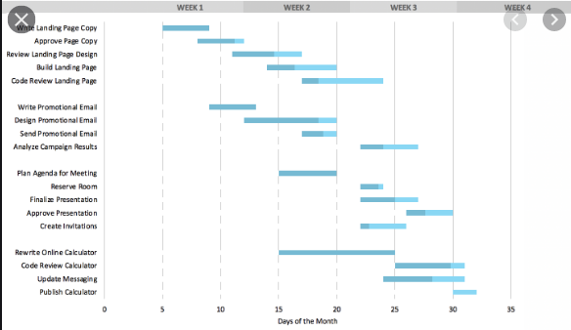
Sample Gantt chart
Prepared by:
MR. CELSO T. AGOS JR.,MSIT
Microsoft Certified Educator
Six Sigma Certified
Science and Technological Specialist
Doctor in Information Technology- on going

Slide 24
Reference:
IT Project Management book by Jack T Machewka
Prepared by:
MR. CELSO T. AGOS JR.,MSIT
Microsoft Certified Educator
Six Sigma Certified
Science and Technological Specialist
Doctor in Information Technology- on going

